Slide 1
STRING EDITING
A klh project

Slide 2
Team members
2010030410 – l.vamsi krishna
2010090004 – mitesh Chandra
2010030174 – t.Sainath reddy
2010030383 – v.abhiram

Slide 3
Problem statement
The string editing problem is to determine the distance between two strings as measured by the minimal cost sequence of deletions, insertions, and changes of symbols needed to transform one string into the other.
Given two strings and operations edit, delete and add, how many minimum operations would it take to convert one string to another string.
This is lavensteins algorithm which is also known as edit distance.

Slide 4
Algorithm and its description
We are going to solve the string editing problem using edit distance algorithm.
More formally, the minimum edit distance between two strings is defined as the minimum number of editing operations (operations like insertion, deletion, substitution) needed to transform one string into another.

Slide 5
explanation
A pre-requisite for applying Dynamic Programming, to solve a problem, is to demonstrate that the solution to the original problem can be found by using the solutions to the sub-problems.
The approach here is somewhat simple and initiative . Consider the strings ‘a’ and ‘b’ for their characters :
If the last characters of both strings are the same, then the edit distance is equal to the edit distance of the same two strings, up to their second-to-last character.
If the last character is different, then the edit distance is equal to the minimum of the cost of inserting, deleting, or replacing the last character of string a.

Slide 6
applications
This is relevant to string matching such as patten recognisation , error correction , and molecular genetics.
In nlp , levenstein(edit distance) is used for suggesting spelling corrections , detecting plagiarism , For example, if a word is misspelt as "ligting", Levenshtein Distance can suggest that "lighting" is most similar, which helps the writer correct the spelling . It's also been used to cluster words that share a root word .
Levenshtein Distance in fact started in signal processing, in particular, to see how errors in communications systems can be corrected. Another application is speech recognition. A perfect match of an audio signal is impossible and edit distance can find the most suitable match .

Slide 7
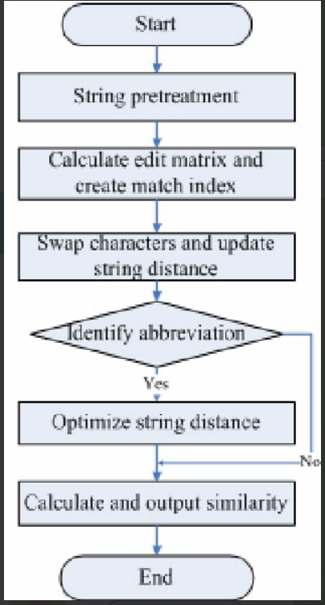
flowchart

Slide 8
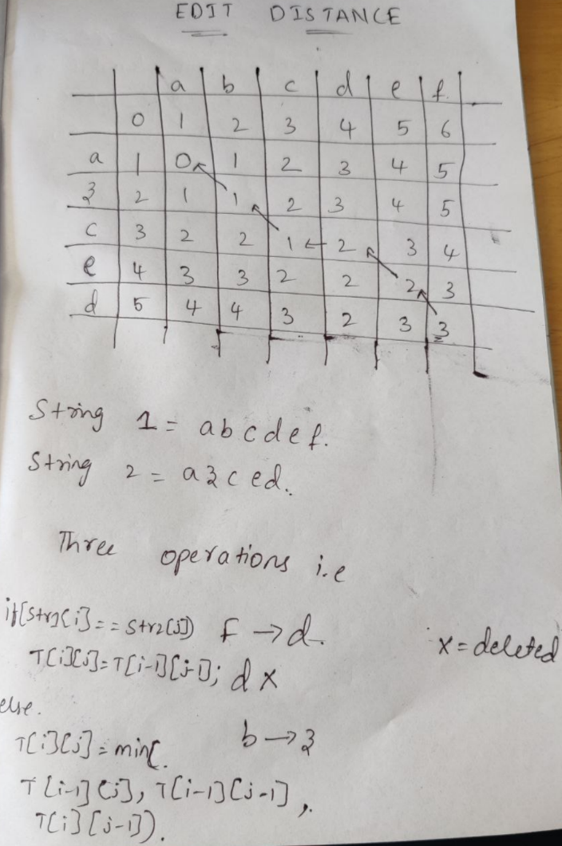
Example of the algorithm

Slide 9
Work division
2010030410 – design of ppt and collecting information
2010090004 – collecting information
2010030383 – code testing
2010030174 – algorithm

Slide 10
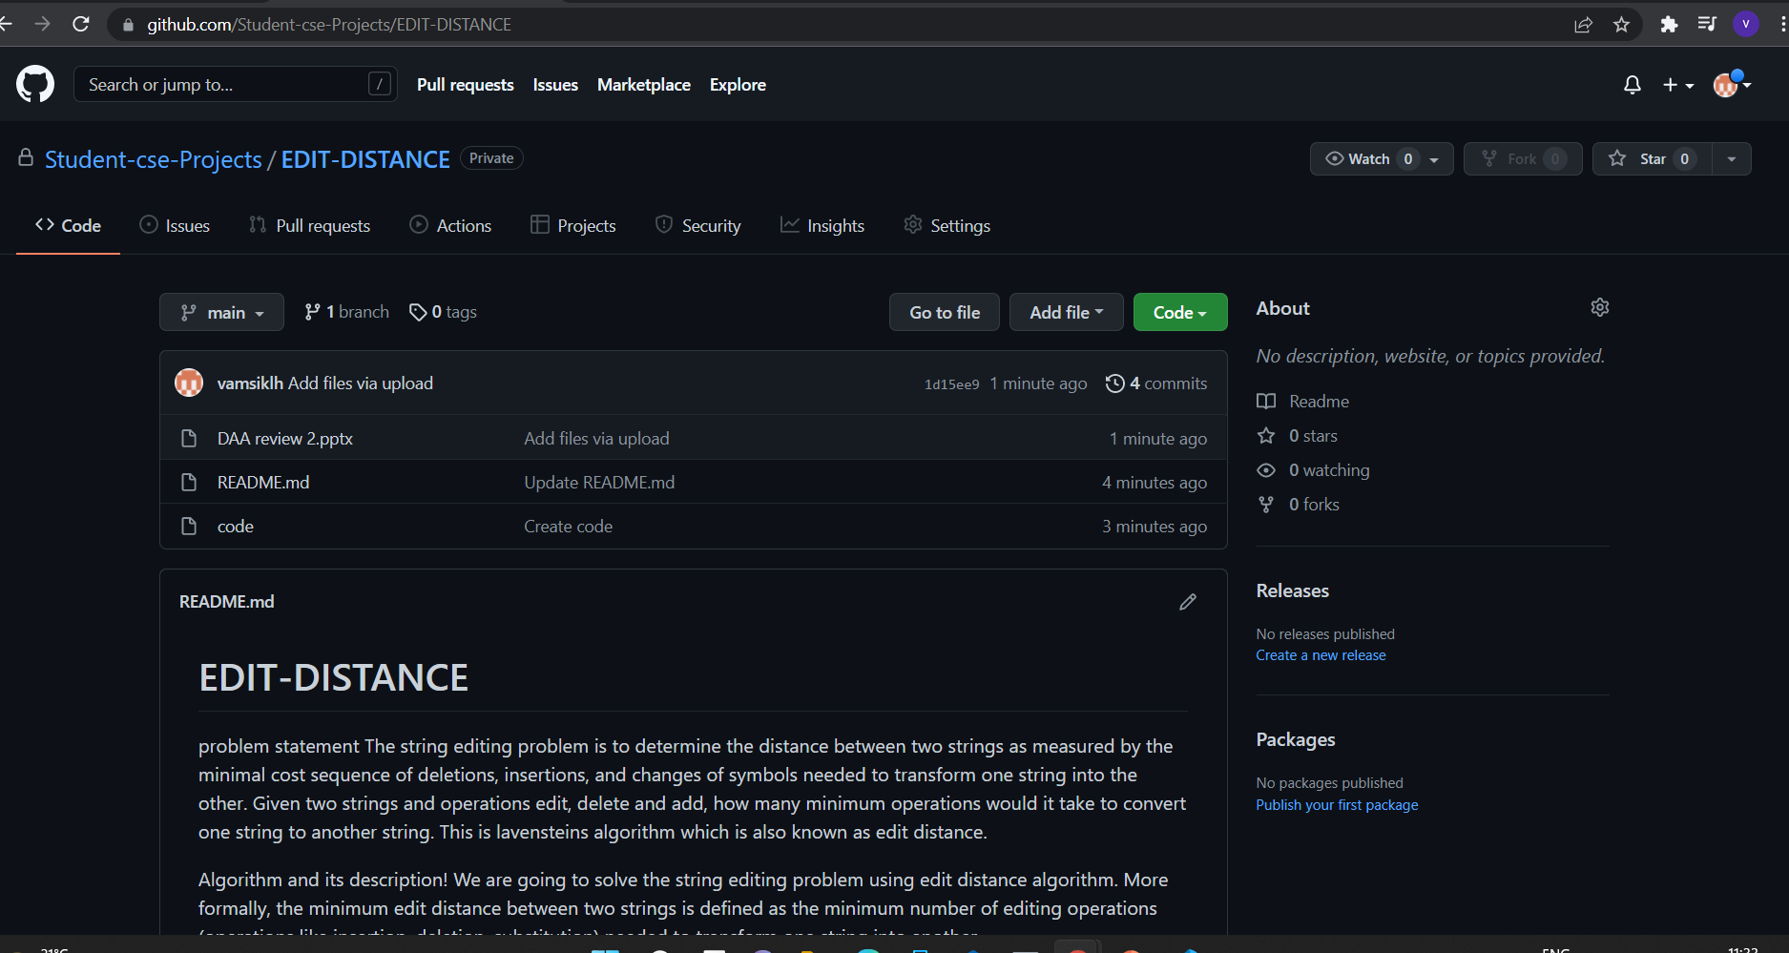
Github commit

